Slide 1
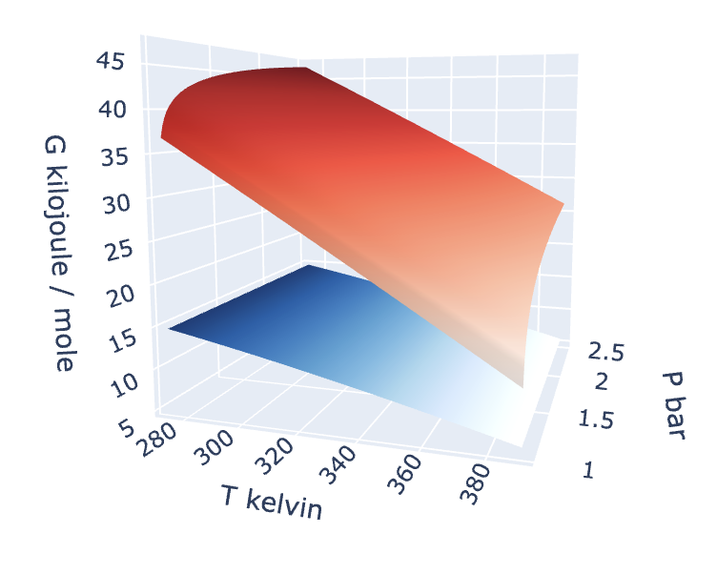
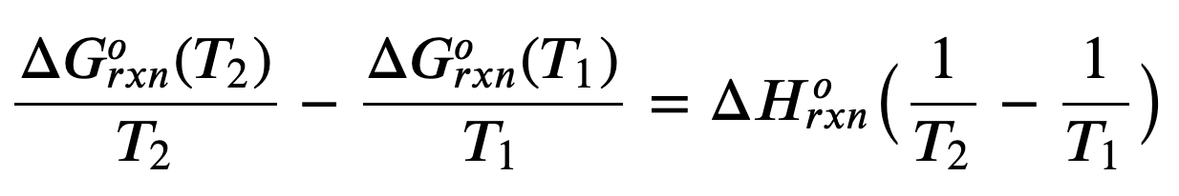
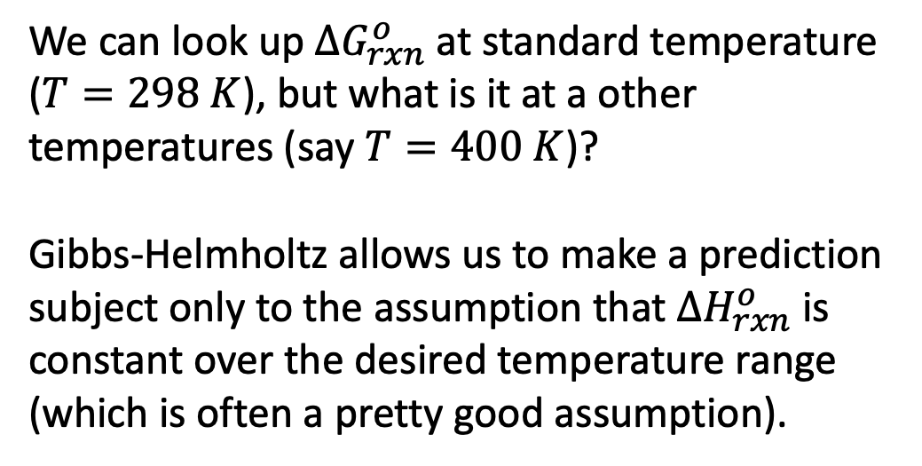


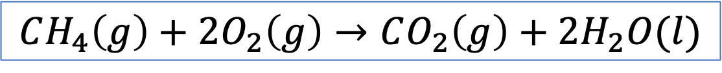
Gibbs-Helmholtz
$$CH_{4}\left(g\right)+2O_{2}\left(g\right)→CO_{2}\left(g\right)+2H_{2}O(l)$$
We can look up $∆G_{rxn}^{o}$ at standard temperature ($T=298 K$), but what is it at a other temperatures (say $T=400 K$)?
Gibbs-Helmholtz allows us to make a prediction subject only to the assumption that $∆H_{rxn}^{o}$ is constant over the desired temperature range (which is often a pretty good assumption).
$$T_{1}$$
$$T_{2}$$

Slide 2
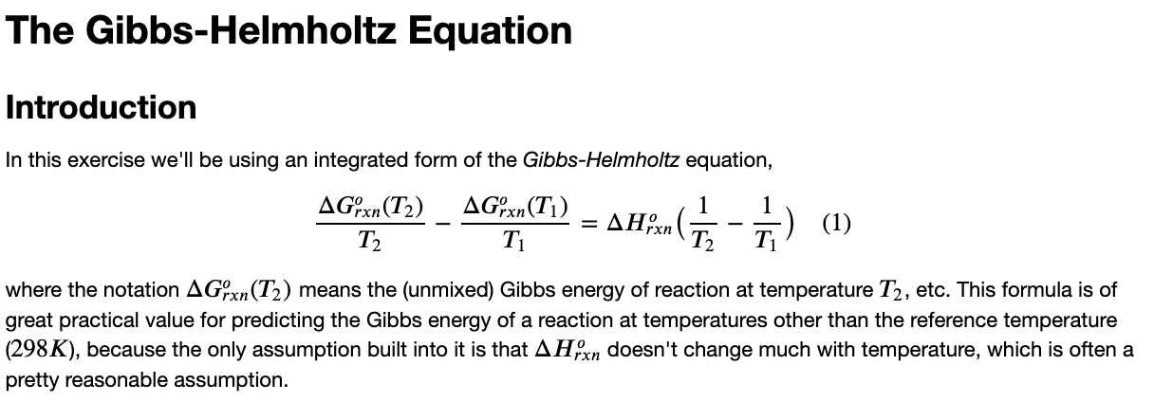
The CGI associated with this

